Slide 1
Cloud Databases and Infrastructure as Code
Drake Pocsatko,
Kadambari Athreya
Nationwide

Slide 2



Instructors
Kadambari Athreya
Cloud Success Team – Consulting
14 yrs. in IT
Nationwide since 2012
Drake Pocsatko
Pittsburgh, PA born and raised
OSU Grad ‘19
Cloud Infrastructure Engineering Team

Slide 3
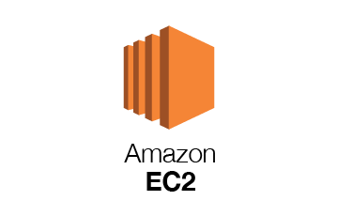


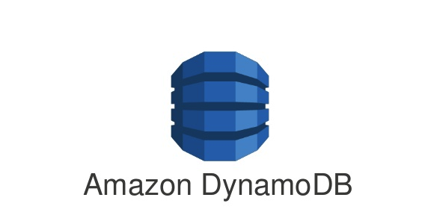

Types of Cloud Databases in AWS
AWS RDS
SQL, Oracle, Amazon Aurora, MariaDB
DynamoDB
NoSQL (Not Only SQL)
ElastiCache
Redis, Memcached
Redshift
Data warehousing
Database on EC2
Any available database AMI

Slide 4
RDS vs DynamoDB
RDS
Traditional style database
Back-end relational database for any enterprise application
Back-end database for web applications
Source systems for data warehouses
Data marts and small data warehouses
Dynamo
NoSQL
Back-end database for modern cloud applications
Back-end database for web applications
Store preferences for click-stream data or IOT
Storage for unstructured data

Slide 5
Benefits of Cloud Databases
Easy deployment
Cost Optimization
Scalability
Auto-start up and shut down
Security
Automated patches
Resilient servers
High Performance

Slide 6
Infrastructure as Code
AWS Cloudformation
JSON, YAML or AWS Cloud Development Kit (CDK)
Allows for immutable infrastructure
Automated deployments using Codepipeline
Treat Infrastructure like Software

Slide 7
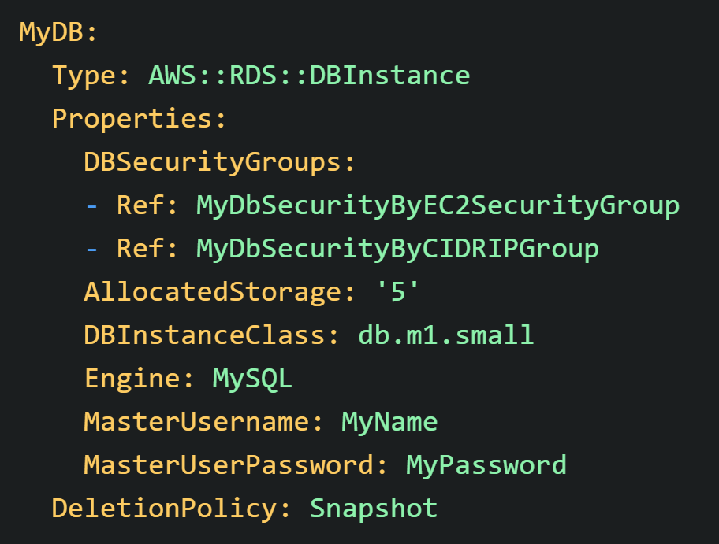
Cloudformation Example

Slide 8
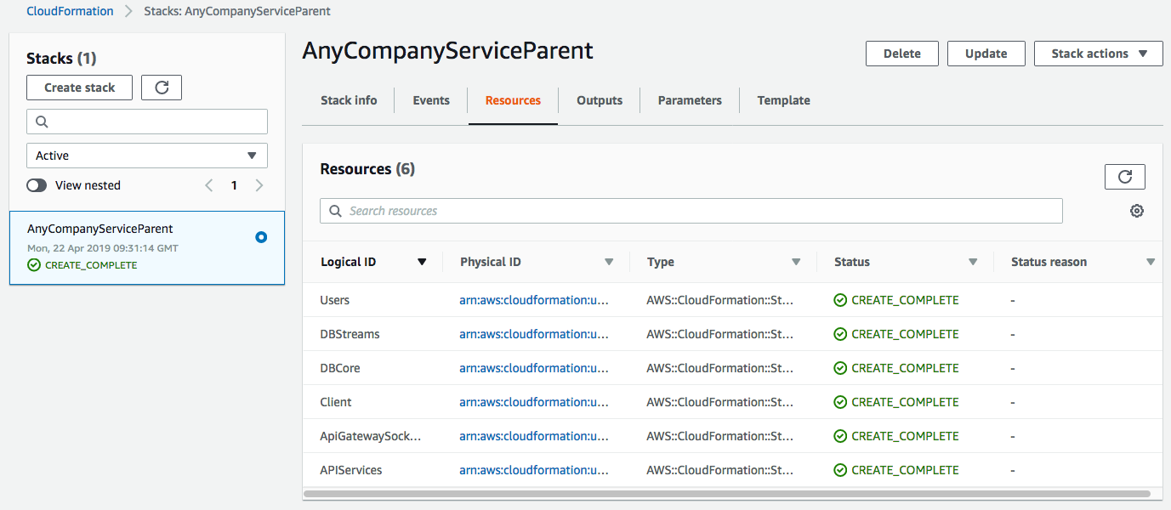
Lab: Deploy rds instance using cloudformation

